Slide 1

Batchnorm on MNIST - Let’s see Source Code

Slide 2
Reference
Paper
Source Code
Youtube
Code

Slide 3
Worm Up

Slide 4
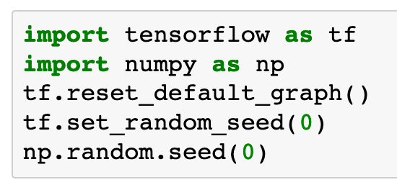

Slide 5
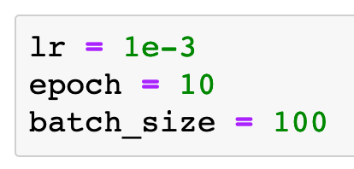

Slide 6
Data

Slide 7
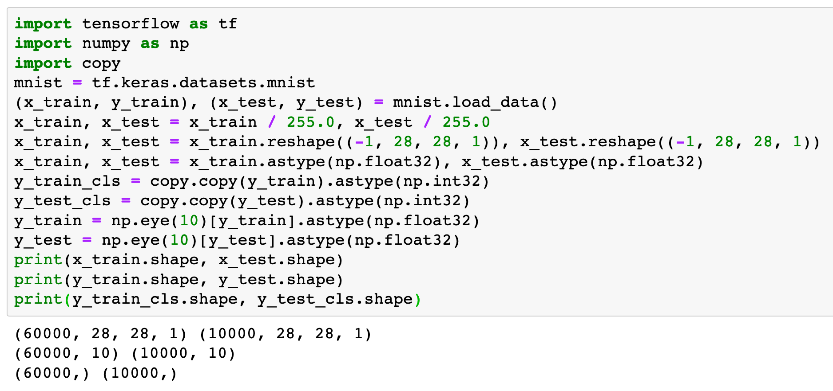

Slide 8
Graph

Slide 9
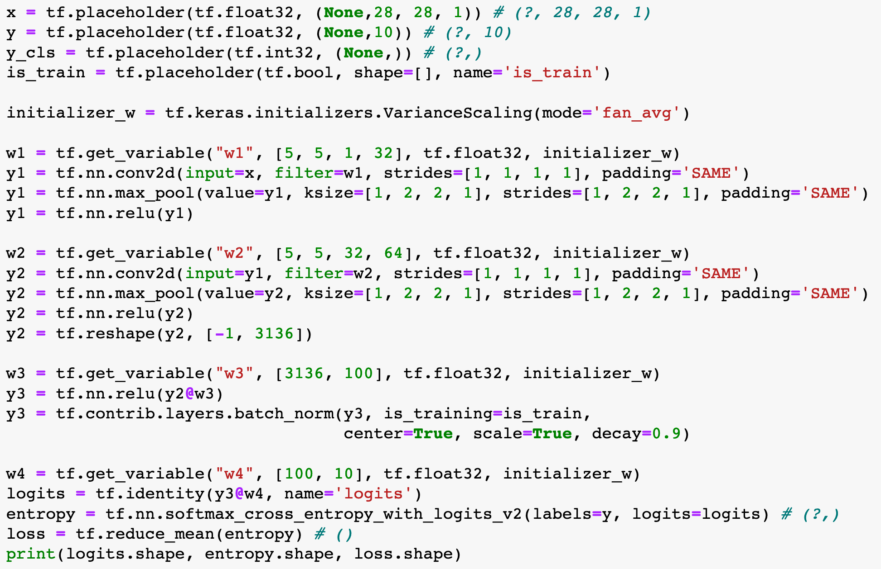

Slide 10
These Lines are added

Slide 11
These Lines are added

Slide 12
Adam

Slide 13
These Lines are added
Adam

Slide 14
These Lines are added
Adam

Slide 15
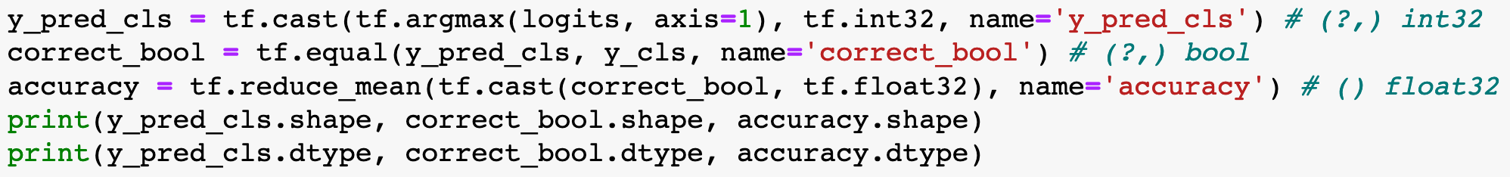

Slide 16
Session

Slide 17
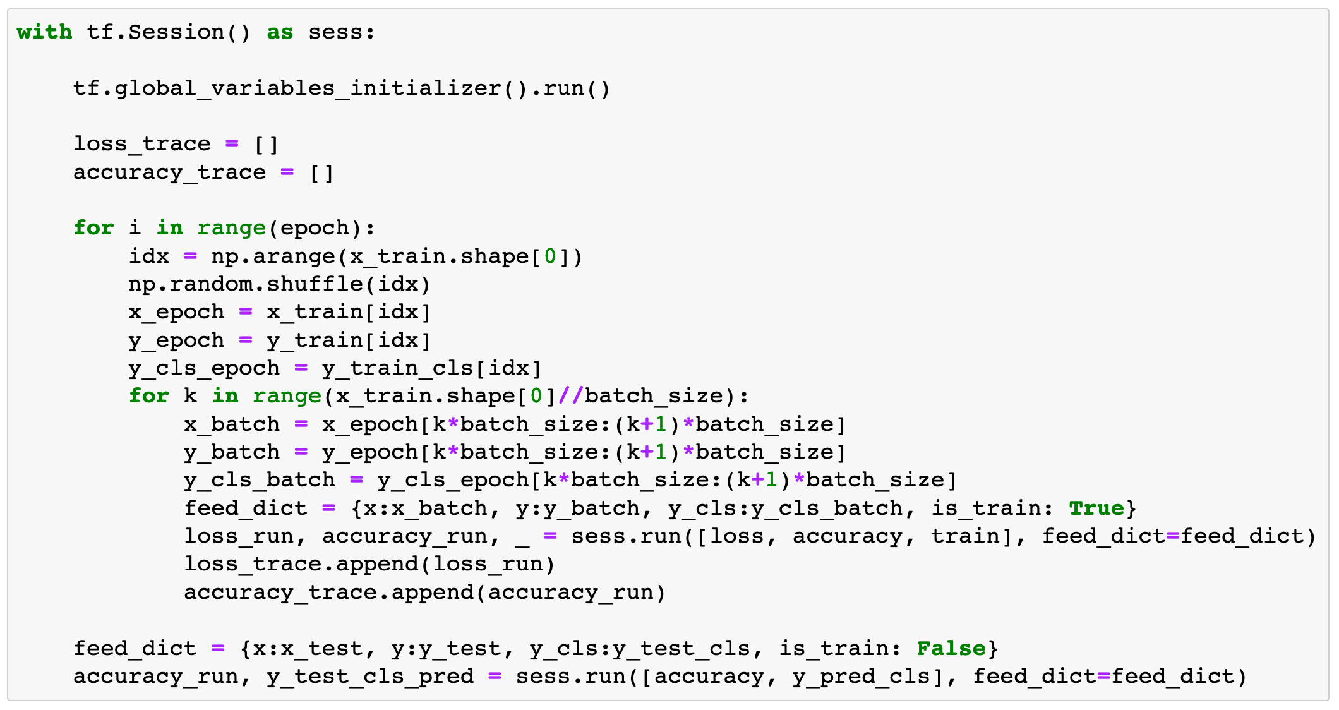

Slide 18
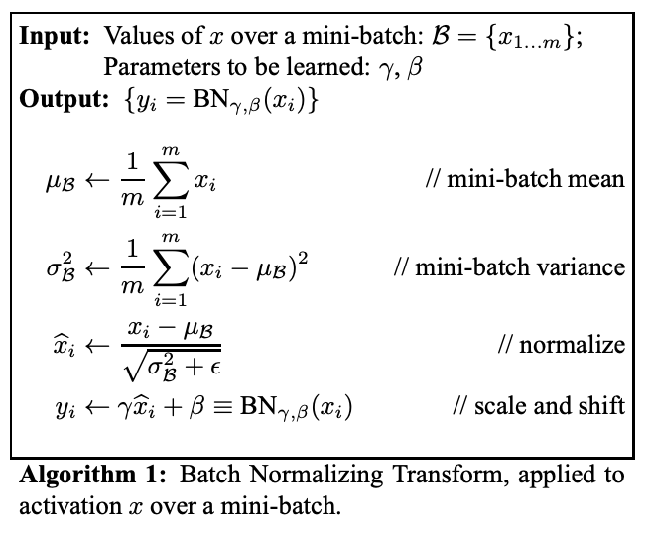
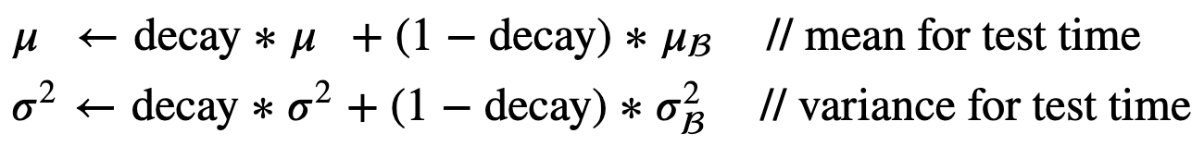
Train Period
Paper

Slide 19
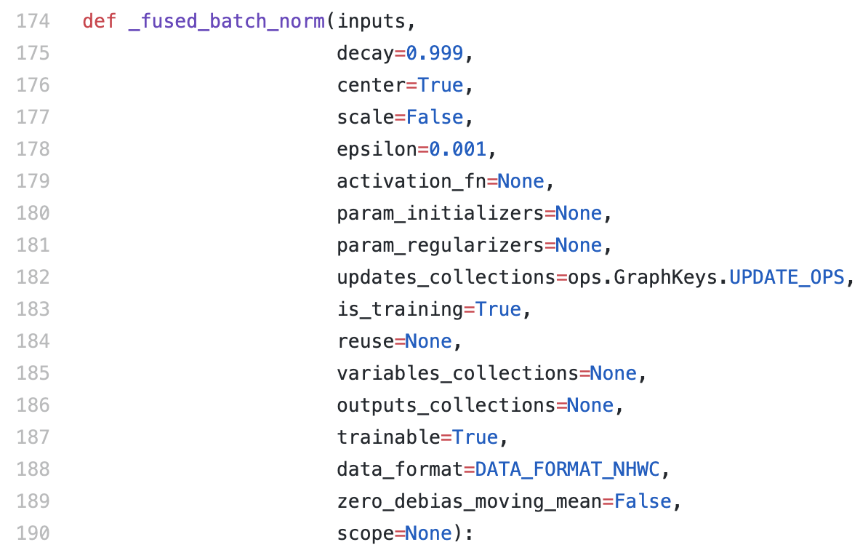
Train Period
Source Code

Slide 20
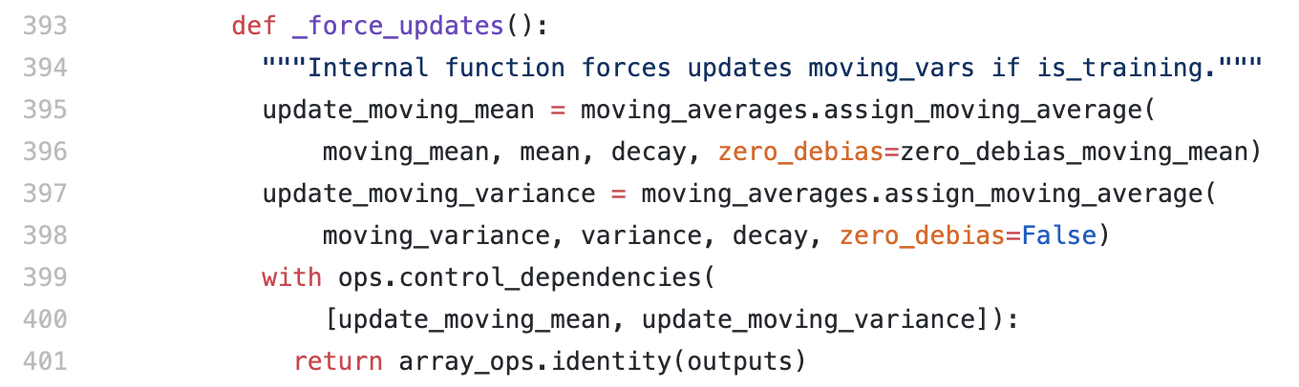
Train Period
Source Code

Slide 21
During train
we update
population mu and sigma
using
exponential moving average

Slide 22

Test Period

Slide 23
During test
we don’t update and just use them
During train
we update
population mu and sigma
using
exponential moving average

Slide 24
Report Result

Slide 25
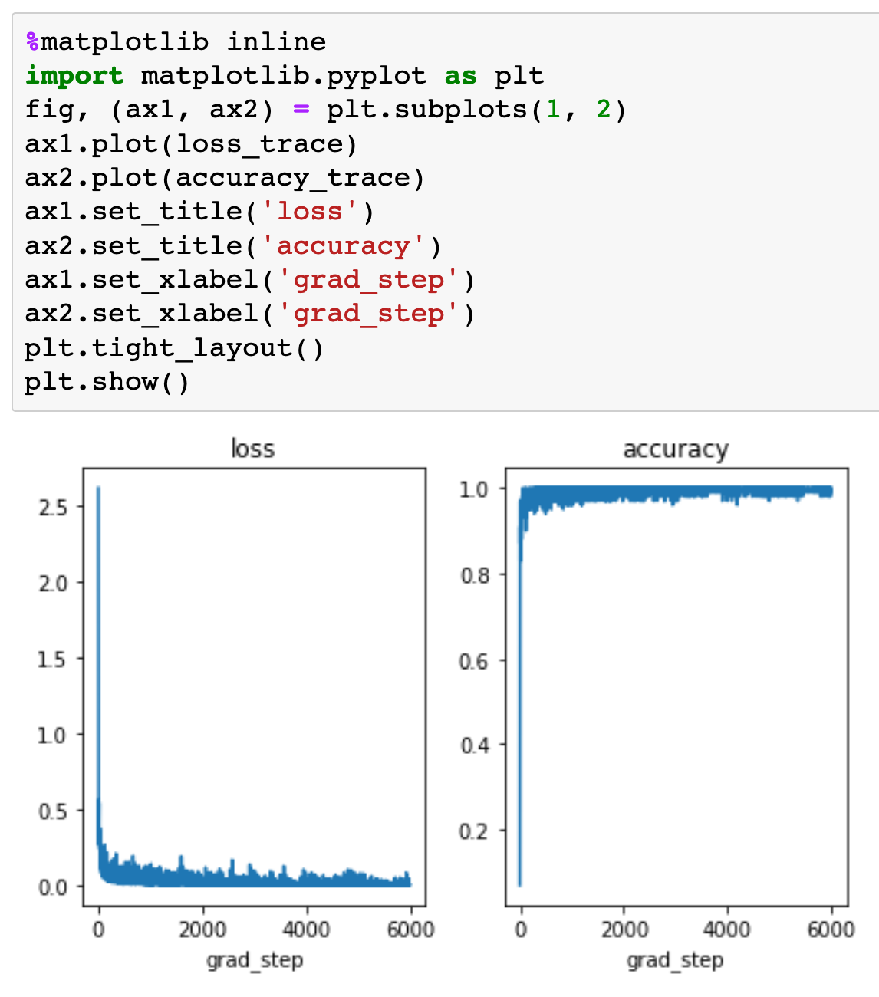

Slide 26
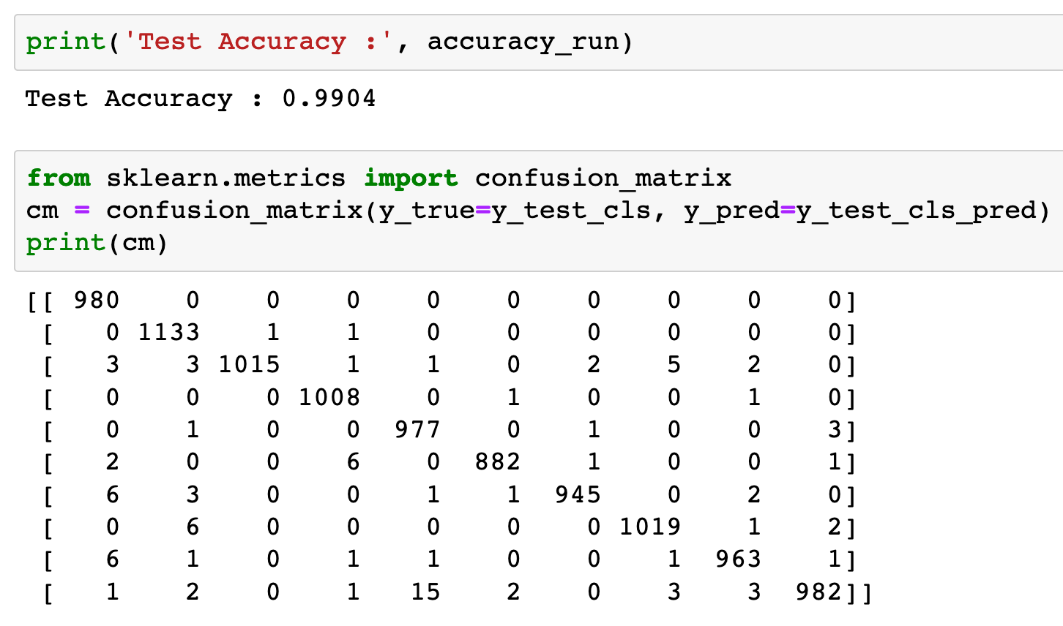

Slide 27
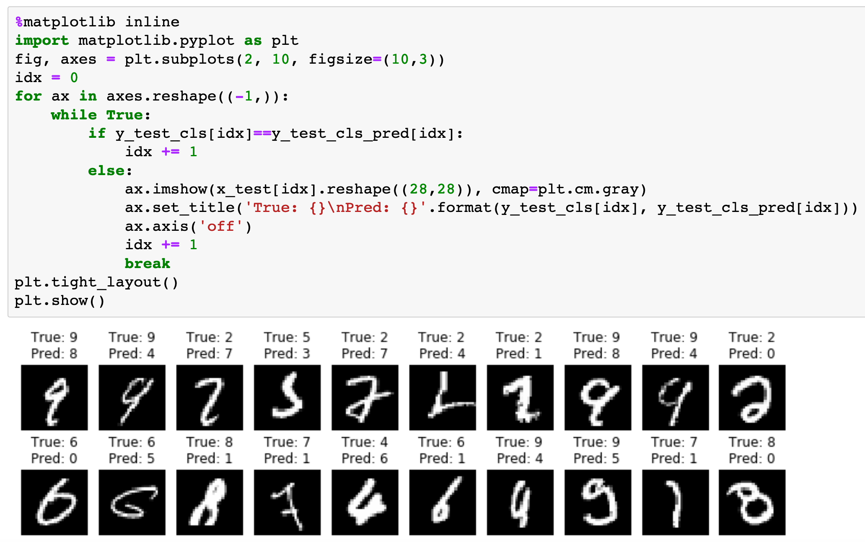

Slide 28
Exercise
1. Implement both batchnorm and dropout on mnist dataset.
2. Implement CNN on fashion_mnist dataset.
3. Implement CNN on cifar10 dataset.

Slide 29
Now
Let’s Play with Code

